Slide 1
Saving lives through
organ, tissue and eye donation

Slide 2
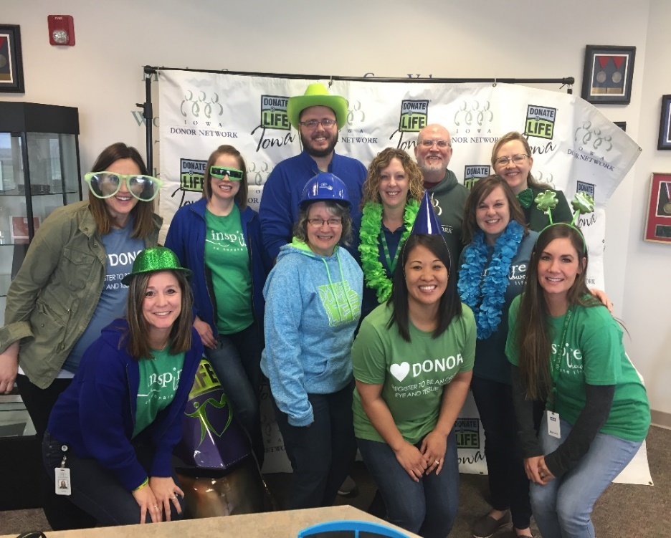
Mission: Working Together to Transform Lives Through Organ and Tissue Donation
Oversee the donation process
Partner with many organizations to help save and heal lives through donation
Provide education to help Iowans become registered donors
Support and honor donors and their families
IDN Staff
Donate Life Month 2019
IOWA DONOR NETWORK
Notes:
How many of you have heard of Iowa Donor Network (raise your hands)?
Iowa Donor Network is a non-profit organization which does incredibly important work! Iowa Donor Network manages Iowa’s database of almost 2 million registered donors, and provides free educational programs to schools, community, businesses, faith centers and media around the state.
There are healthcare professionals at Iowa Donor Network who oversee the donation process and support families when their loved one becomes a donor. Today you will learn more about organ, tissue and eye donation, the process and how it impacts our community.

Slide 3
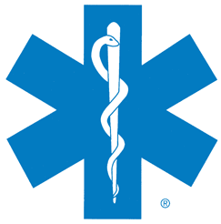
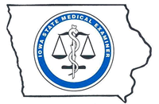
Iowa Donor Network Partners
Notes:
As I mentioned in the last slide, IDN has many great partners that help us save lives including hospitals, transplant centers, EMS/Fire, Law Enforcement, long term care facilities, medical examiners, funeral directors and DMVs.
Hospital
EMS/Fire
Long Term Care
Law Enforcement
Medical Examiners
Funeral Directors
DMVs
Hospitals are the only agencies in Iowa that are required to report patient deaths to the OPO (IDN). None of these other agencies are required to make that call. There are approximately 30,000 deaths in the state each year, and less than 12,000 of those get reported to IDN. What does this mean? There are many Iowans who wish to be organ/tissue/eye donors at the time of their death but they are never given the opportunity.

Slide 4
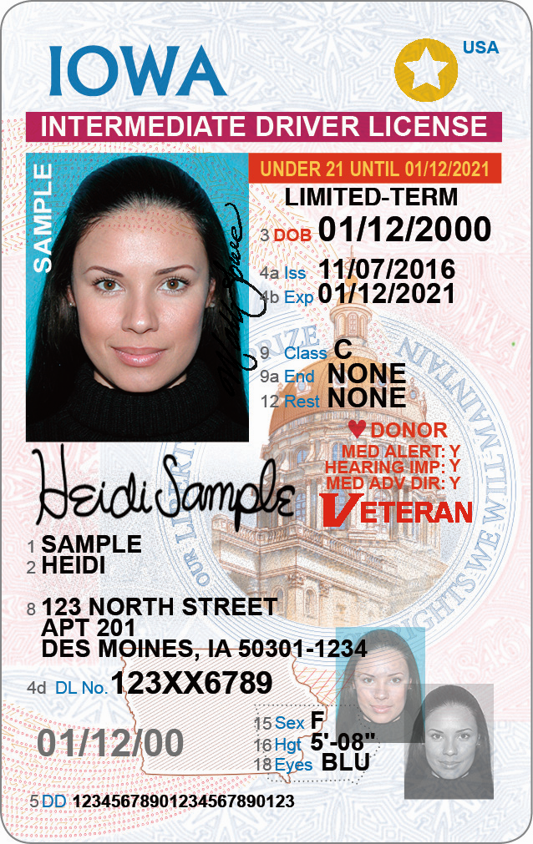
Your driver’s license will show
DONOR
Notes:
I have the opportunity to share this information with you today thanks to our amazing partnership with the Department of Transportation and DMVs. How many of you already have a driver’s permit?
When you turn 14, you are asked by our partners at the DMV if you want to be a donor.
If you are a registered donor, a heart with the word “Donor” next to it will appear in the bottom right hand corner of the drivers license. (Note: If you obtained your license prior to June 2018 it will say “Donor Y” until you renew. Both are valid forms of first person consent)
If you are NOT registered, nothing will appear.

Slide 5
Registering to be a Donor
Registering to be a donor means a person is choosing to donate their organs, corneas or tissues to people who are waiting for a transplant.
Individuals under the age of 18 can be registered donors however, parents have all final legal decisions.
Registering to be a donor does not include living donation or research.
Notes:
Individuals under the age of 17 can be registered organ, eye and tissue donors however parents have all final legal decisions.
If potential donor is not registered, next-of-kin makes the final decision.

Slide 6
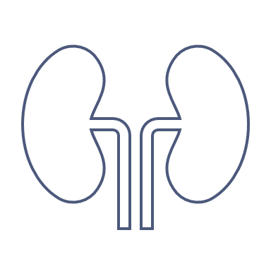
What is organ, tissue and eye donation?
Notes:
You can begin this discussion by asking about what donation is in general. What kinds of things can you donate (money, hair, clothes, food, blood, etc.)? This is a good way to get students involved early on in the class. Share that we will not discuss blood/bone marrow donation, etc. – these are different types of donation.
OTE donation is the process of surgically recovering an organ or tissue from one person (the donor) for transplant to a living recipient. An organ transplant is necessary when a person’s organ has failed or has been damaged by disease or injury.
Recovered tissues (for example--skin, bones and tendons) are used to create grafts for transplant.
A corneal transplant is a surgical procedure that replaces part of a person’s cornea with corneal tissue from a donor. The cornea is the clear dome-like window covering the front of the eye that allows the light to pass through to the retina, and enables us to see.
Tissue and cornea donation can greatly improve a person’s quality of life.
At the end of your life, you can give life to others.

Slide 7
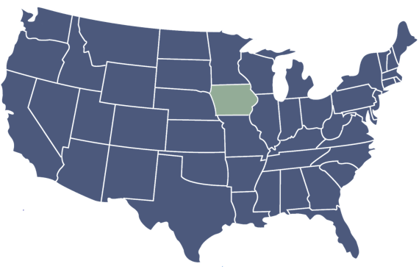
Organ Transplant Waiting List
2025
104,000+
Men, women, and children are waiting for a life-saving transplant in the U.S.
550+
Iowans are waiting for a life-saving transplant
Notes:
85% of patients on the organ transplant waiting list are waiting for a kidney.

Slide 8
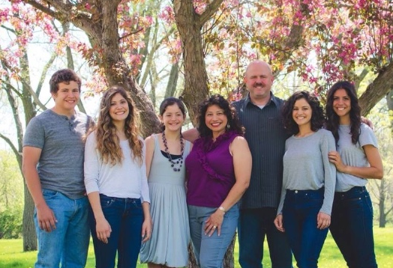
Why do families choose donation?
Doing the right thing
Helping others
Living on
Believing something good came from death
Fulfilling a family member’s wish
Hogan, N.S., Coolican, M., & Schmidt, L.A. (2013)
“As a donor family, we have found comfort in our grieving thinking about the lives our daughter Micaela has helped and in honoring her wishes to be an organ and tissue donor. Iowa Donor Network has helped us continue her legacy of love and helping others long after her passing. What a beautiful way to honor a life so loved and deeply missed.”
- Brunson Family
Notes:
(Photo info: Alma and Brian Brunson’s daughter, Micaela, was a donor in 2016. Alma and Brian honor her life and legacy as volunteers for Iowa Donor Network.
When faced with the decision to choose organ, tissue or eye donation for a loved one, why do families say “yes”?
In a qualitative study conducted by Hogan, Coolican, and Schmidt, researchers asked participants (107 family decision makers) whose family member died in a traumatic sudden death and had authorized donating tissues for transplant, two primary questions. First, “If you could ask or tell your dead family member something, what would it be?” and “What meaning does donating tissue to others have for you?” Concepts derived from the first question were 1) feeling empty, 2) missing and loving, 3) being grateful, 4) having regrets. Concepts derived from the second question were 1) fulling a family member’s wish, 2) doing the right thing, 3) believing something good came from death, 4) helping others, 5) living on. Reasons for donating were based, in part, on honoring the legacy of their loved ones who had given of themselves to others in life and now continued to give to others after death. Hogan, N.S., Coolican, M., & Schmidt, L.A. (2013). Making meaning in the legacy of tissue donation for donor families. Progress in Transplantation. 23. 2. pp. 180-187.

Slide 9
How IDN supports donor families
Fulfill decision of registered donors
Guide and support families through end-of-life decision making and grieving
Life-saving mission: advocate for patients on the transplant waiting list
Notes:
What is IDN’s role in supporting families who choose donation?
Fulfill decision of registered donors
Guide and support families through end-of-life decision making and grieving
Life-saving mission: advocate for patients on the transplant waiting list

Slide 10
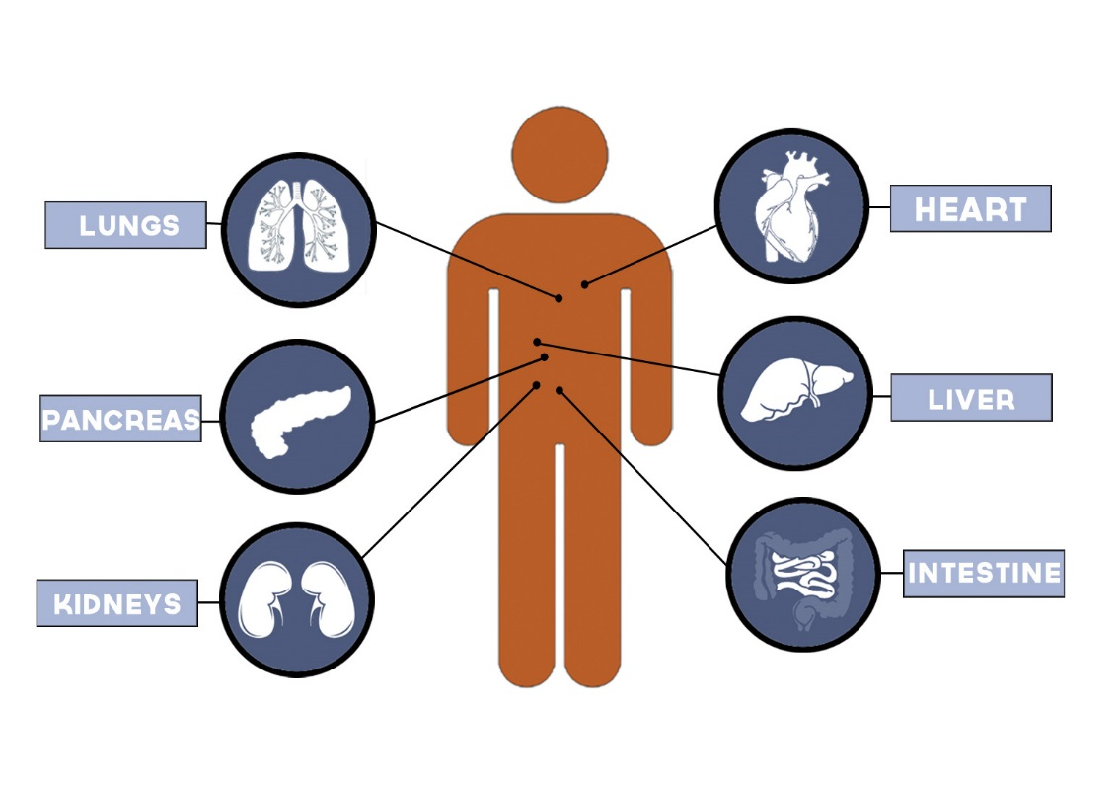
Which organs can be donated?
Heart & Lungs:
4 – 6 hours
Liver:
8 - 12 hours
Pancreas & Intestine:
12 - 14 hours
Kidneys:
up to 36 hours
Notes:
When we talk about “organ” donation, we are referring to internal solid organs.
The organs that can be donated include heart, lungs (can be transplanted en bloc or can be separated for two recipients), liver (can be segmented for two recipients), kidneys (almost always separated for two recipients), pancreas, and small intestine.
Brain death is usually the result of severe trauma which causes brain tissues to swell. What types of injuries may occur to the brain that would result in brain death? Hemorrhagic stroke, blunt force trauma (MVA, fall, etc), gunshot wound, anoxic injury, tumors, meningitis are all examples.
Each organ has a window of time from when it is recovered in the OR to when it must be transplanted.
Heart and Lungs: 4 – 6 hours
Liver: 8 – 12 hours (the sooner the better)
Pancreas and Intestine: 12 – 14 hours (the sooner the better)
Kidneys: up to 36 hours if we use a kidney pump

Slide 11
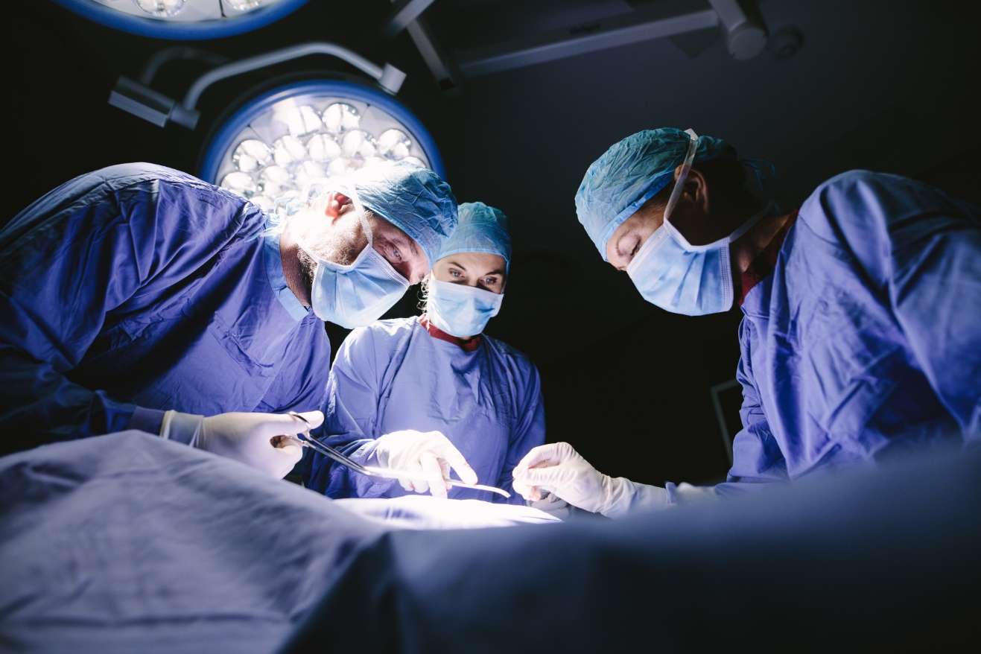
Organ Recovery
Organ recovery takes place in an operating room at a hospital.
There are no costs to a donor family for the donation process.
Being an organ or tissue donor does not interfere with funeral arrangements.
Donors and families are treated respectfully throughout the process.
Notes:
What is the process of recovering organs from a donor?

Slide 12
Organ Donors in Iowa
In 2024, 130 Iowans gave the gift of life through organ donation.
Saying “yes” to donation allowed for 387organs to be successfully transplanted.
Notes:
2021 was the fourth straight record year for organ donation in Iowa. We have had a 75% increase in organs transplanted over the last 5 years.
2020: 103 donors, 300 organs transplanted 2020 was the third straight record year for organ donation in Iowa. We have had a 75% increase in organs transplanted over the last 5 years.
2019: 92 donors, 290 organs transplanted
2018: 74 donors, 248 organs transplanted
2017: 54 and 165
2016: 55 and 171

Slide 13
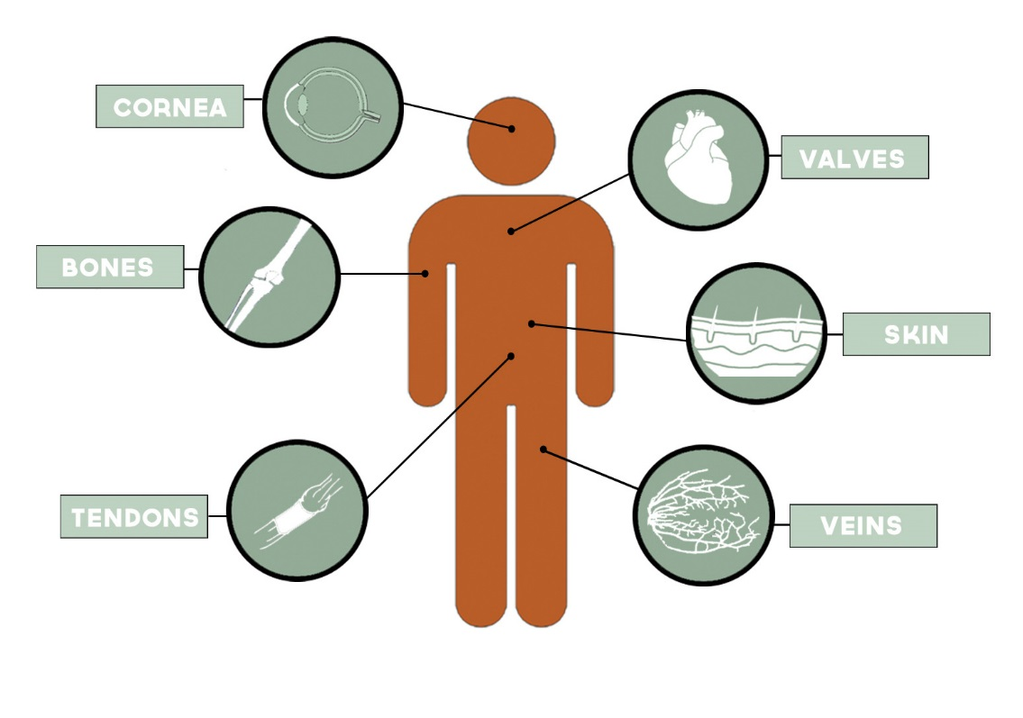
Tissue and Cornea Donation
Restore sight for those suffering from Fuch’s Dystrophy, Glaucoma, Keratconus, Trauma, Ulceration
Aortic Iliac – helps trauma patients requiring vascular surgery or for bypass of diseased vessels in AAA surgeries
Vertebral Bodies – stem cells used to create immunotherapies for transplant recipients
Adipose – stem cells added to bone from same donor, used to treat fractures or trauma in places bone won’t grow on its own
Costal Cartilage – helps patients who need facial reconstruction due to trauma or surgical procedures
Used for congenital heart defects or other valve disease
Saves injured extremities, replaces joints, used in spinal fusion and dental surgeries
Life-saving for burn patients, used in cleft palate repair, wound treatment, post-mastectomy grafts
(and other soft tissues) Repairs torn tissues. Uses in sports injuries
Used in bypass grafts to restore circulation to heart or extremities
Notes:
Cornea
Can restore sight for two different people if both corneas are donated.
ILEB only recovers the cornea for transplant – not the whole globe. The whole globe may be recovered for research. In Iowa, the research area is a small pocket of hospitals around Iowa City.
Corneas are usually transplanted 3 – 5 days after being recovered.
Cornea is avascular – no need for tissue or blood typing when needing a cornea transplant.
If you have a cornea transplant, it does not change the color, shape, or size of your eye.
People who wear glasses, contacts, have cataracts or macular degeneration can still donate corneas and restore sight for others. None of these things affect the health of the cornea.
If you have had Lasik surgery after 2006, you can be a cornea donor.
Bones
We recover the long bones from the arms and legs (humerus, ulna, radius, femur, tibia, fibula). Anytime we recover bone our tissue recovery team will place prosthetics to maintain the integrity of the limb for viewing.
Bone grafts help patients with traumatic injuries and patients with bone cancer. Can also be used in spinal fusion and dental surgeries.
Tendons/Ligaments/Cartilage
Soft tissue is recovered in tandem with bone tissue. Often used in sports injury repairs (ACL, PCL, achilles, etc). Can also be used in rotator cuff repair.
Heart Valves
Often transplanted into children who are born with a heart valve defect. Can also be transplanted into adults who have valve disease.
Skin
Skin is recovered primarily from the back (shoulder blades to buttocks) and legs (circumferentially). It can also be recovered from the arms and abdomen (we get special permission from the family before doing this).
Skin grafts can be used for burn patients, wound treatment, post-mastectomy reconstruction, hernia repair, bladder slings, cleft palate repair (and others).
Currently no upper age limit on skin donation in Iowa.
AlloDerm is an example of a graft created from skin donation.
1. Acellular graft created from full-thickness skin. During processing, cells are removed, leaving behind a scaffolding.
2. Promotes the patient’s own cell repopulation, revascularization, and soft tissue regeneration. Basically, the graft allows the patient’s own tissues to regenerate and the graft takes on the form of the tissues being repaired.
3. Resists infection and adhesion formation, has minimal foreign body response.
4. Transplant applications include: gingiva, ligaments, tendons, abdominal wall reconstruction, hernia repair, bladder slings, breast reconstruction post mastectomy, pelvic floor repair, limb repair, chronic wounds, facial tissue, rotator cuff, chest wall and cardiac surgeries, contracture and burn release repair, cleft palate repair, and neonate gastroschises.
Veins
Saphenous and Femoral veins – both from the leg.
Used for cardiac bypass, peripheral bypass, fistula for dialysis.
Other
Aortoiliac (AI) – recovered from diaphragm to groin vessels. Tissue is used to help trauma patients requiring vascular surgery or for bypass of diseased vessels in AAA (abdominal aortic aneurysm) surgeris.
Vertebral Bodies (VB) (no longer research only) – typically involves T1-L5. Bone marrow and stem cells from the VB is being used for immunotherapies for organ transplant recipients.
Adipose – stem cells from adipose are added to the cancellous (softer part) of bone from the same donor. These grafts are then used to treat non-union fractures/trauma or places bone won’t grow on its own. The stem cells become bone, using the cancellous bone they are added to as a scaffold to grow on.
Costal Cartilage
Cartilage taken from in-between the ribs (chest plate is what is recovered) to be used for facial reconstructions due to trauma. *falls under musculoskeletal tissue*

Slide 14
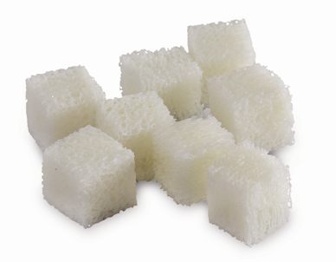
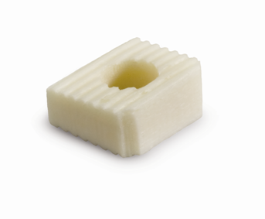
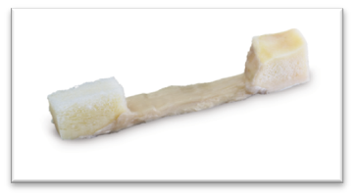
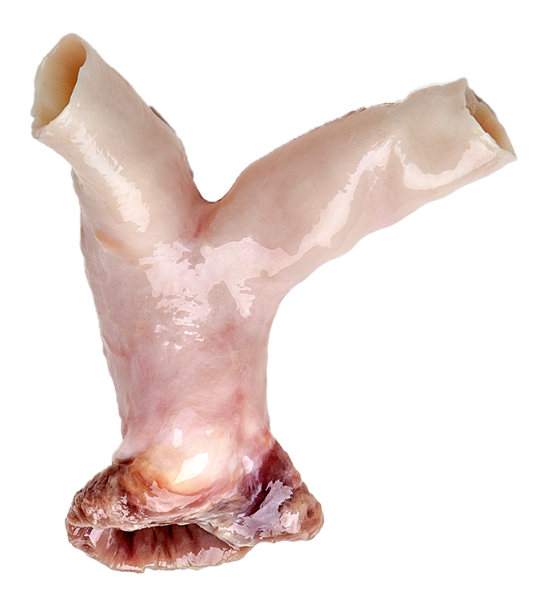
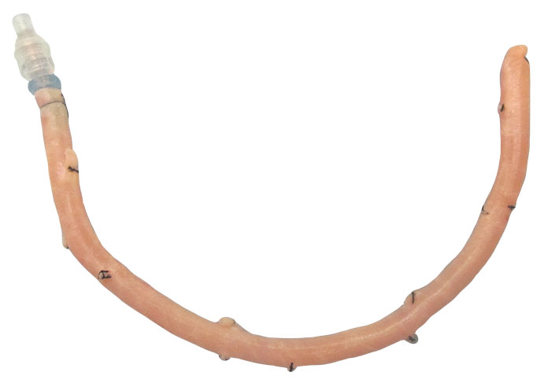
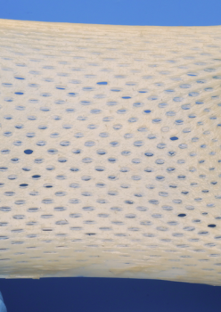
Tissue Grafts
Tendon for ACL Repair
Machine Grafts for Spine
Cancellous Cubes from Bone
Allograft Skin for Burns and Wounds
Pulmonary Valve
Femoral Vein
Notes:
Examples of grafts after they are processed and ready for transplant.
Cancellous Cubes or Chips can be used for bone regeneration.
Vein grafts may be used for cardiac or peripheral bypass surgery. May also be used to create a fistula for dialysis patients.
Skin grafts may be used in burn treatment, wound treatment, or in reconstructive surgeries such as breast reconstruction after mastectomy.
Pulmonary Valve grafts: size of the graft has to match size of the recipient. Allograft valves may not require blood thinners like a mechanical valve would. Allograft valves transplanted into pediatric patients may require fewer surgeries over the patient’s life since the graft may grow with the patient.
Grafts may be stored for up to 5 years before they need to be transplanted.

Slide 15
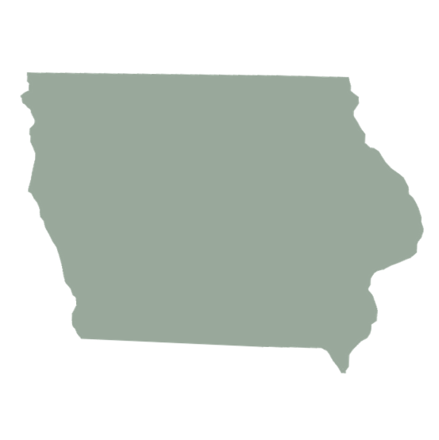
Tissue Donors in Iowa
In 2024, 1,118 Iowans improved and healed the lives of others through the gift of tissue donation.
One tissue donor can impact 50-300 different people.

Slide 17
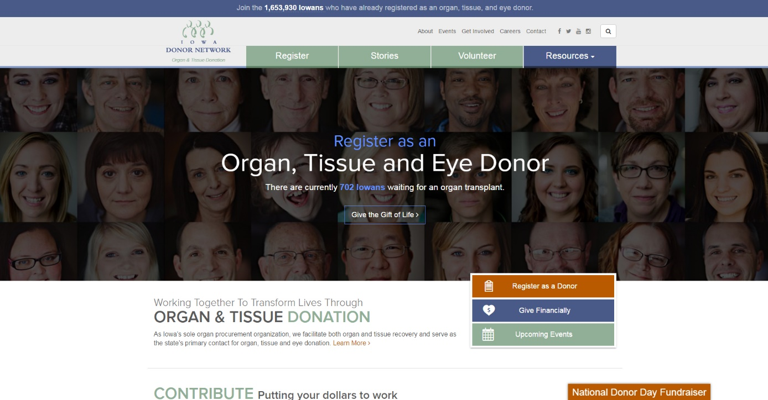
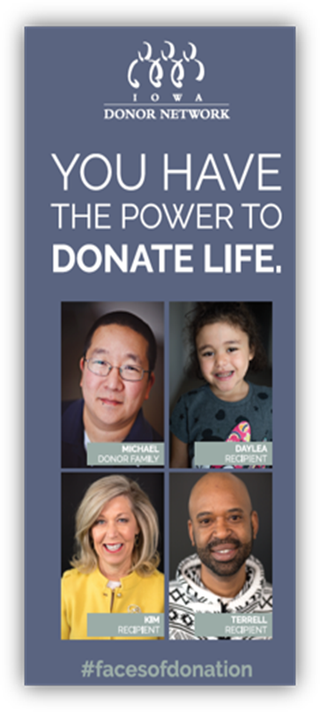
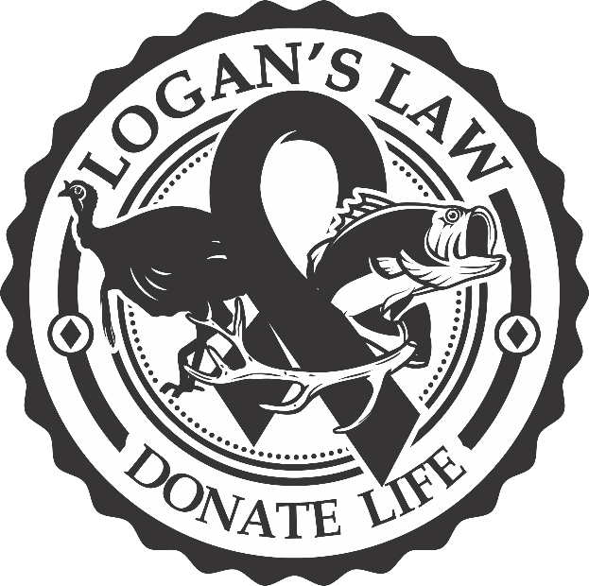
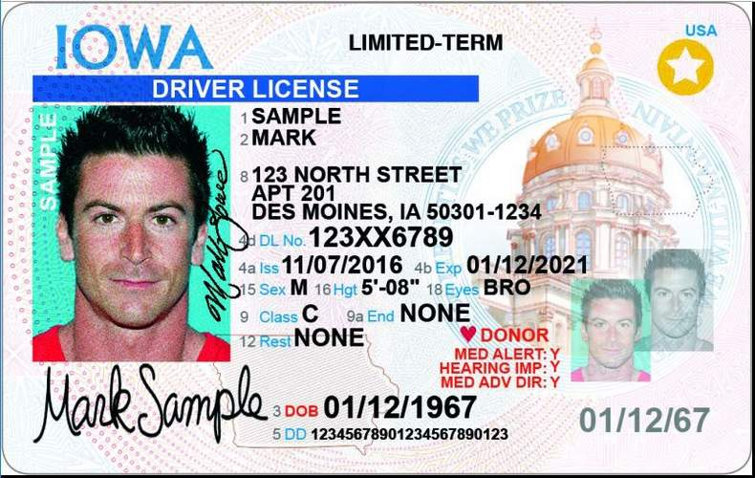
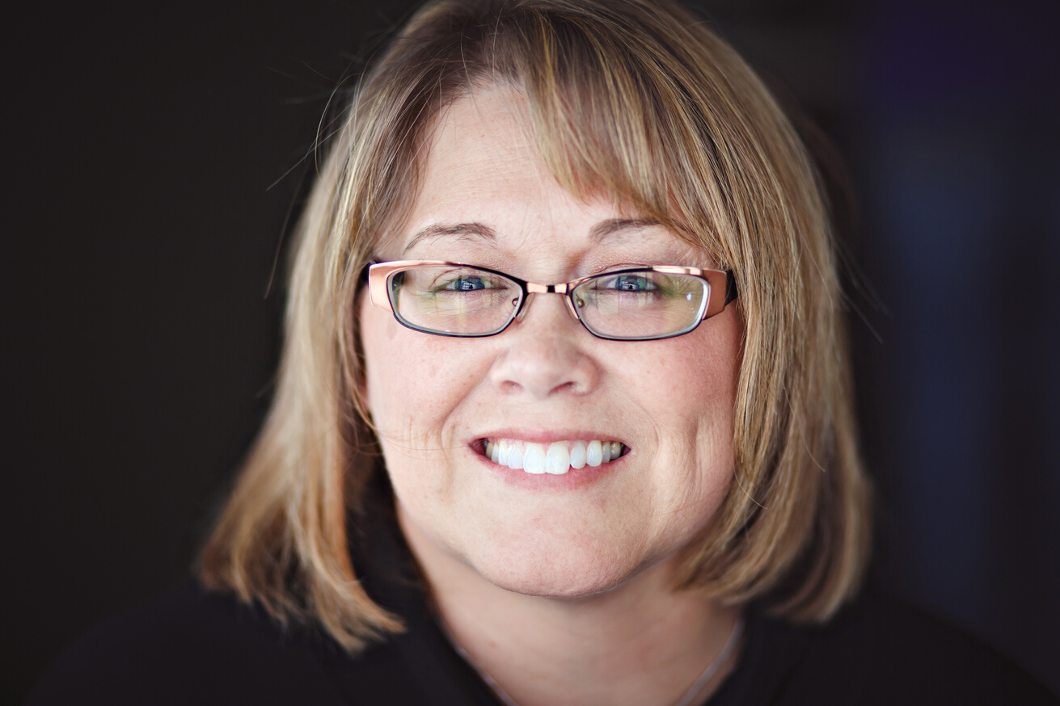
How do I become a registered DONOR?
Leslie Becker
Kidney and Pancreas Recipient
Notes:
Iowa Donor Network is responsible for maintaining Iowa State Donor Registry per Iowa Law.
In Iowa – there are four ways to make a donation decision known.
Register at the DMV when obtaining or renewing of drivers license
Register on the IDN website
Register by mail\
Logan’s Law: Individuals have the option to register when obtaining a hunting, fishing, or fur harvester license. Logan’s Law is named after Logan Luft, a 15-year-old Charles City boy who was an organ and tissue donor. Since it was signed into law in 2019, more than 3,000 people have added their name to Iowa’s Donor Registry through Logan’s Law.
People can also complete a living will and indicate their donation decision in that.

Slide 18
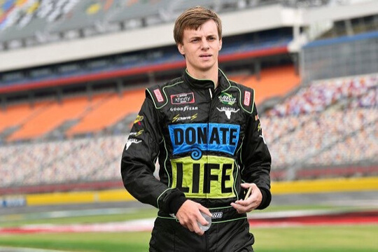
What did you learn today?
1. Why is it important to register as a donor? 2. How many people in Iowa are currently waiting for an organ transplant? 3. Name 3 organs that can be donated. 4. Name 3 tissues that can be donated. 5. Name 2 ways you can register to become a donor.
Joey Gase
Donor Son
Notes:
1. To legally document your decision to be an organ, eye or tissue donor at the time of your death, to help families through end-of-life decision making, to give hope to thousands of people who are waiting for a life-saving transplant
2. Waiting list in Iowa: 600+
3. Organs that can be donated: Heart, Liver, Lungs, Kidneys, Pancreas, Intestine
4. Tissues that can be donated: Corneas, Bones, Tendons, Heart Valves, Skin and Veins
5. Ways to register to become a donor:
Register at the DMV when obtaining or renewing of drivers license
Register on the IDN website
Register by mail
NEW in 2019: Individuals will have the option of registering when obtaining a hunting, fishing, or fur harvester license. Logan’s Law is named after Logan Luft, a 15 year old Charles City boy who was an organ and tissue donor.

Slide 19
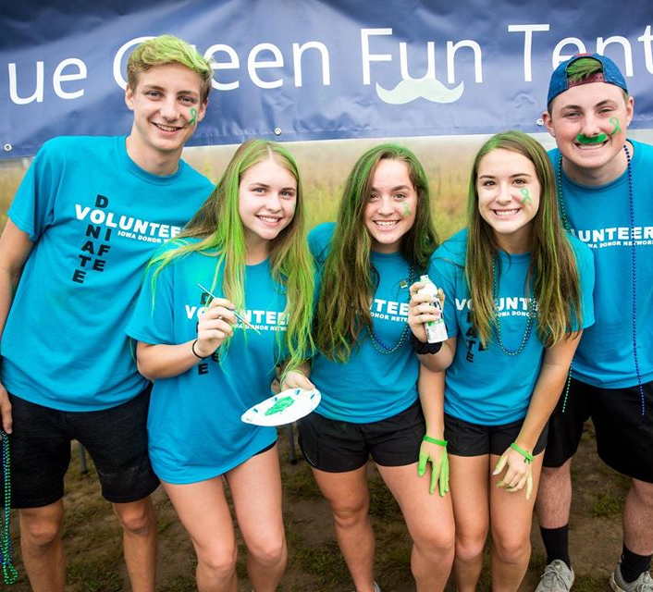
What can you do today?
Mark Yes! Register as a donor.
Talk to your family about your decision.
Get involved! Volunteer with IDN.
Notes:
Many high school students volunteer with Iowa Donor Network to earn silver cord hours. There are also opportunities to volunteer in IDN’s offices and at community events.

Slide 20
Questions?
www.IowaDonorNetwork.org

